Slide 1
Know Your Rights!
DC Code § 42–3505.06.
Right of Tenants to Organize

Slide 2
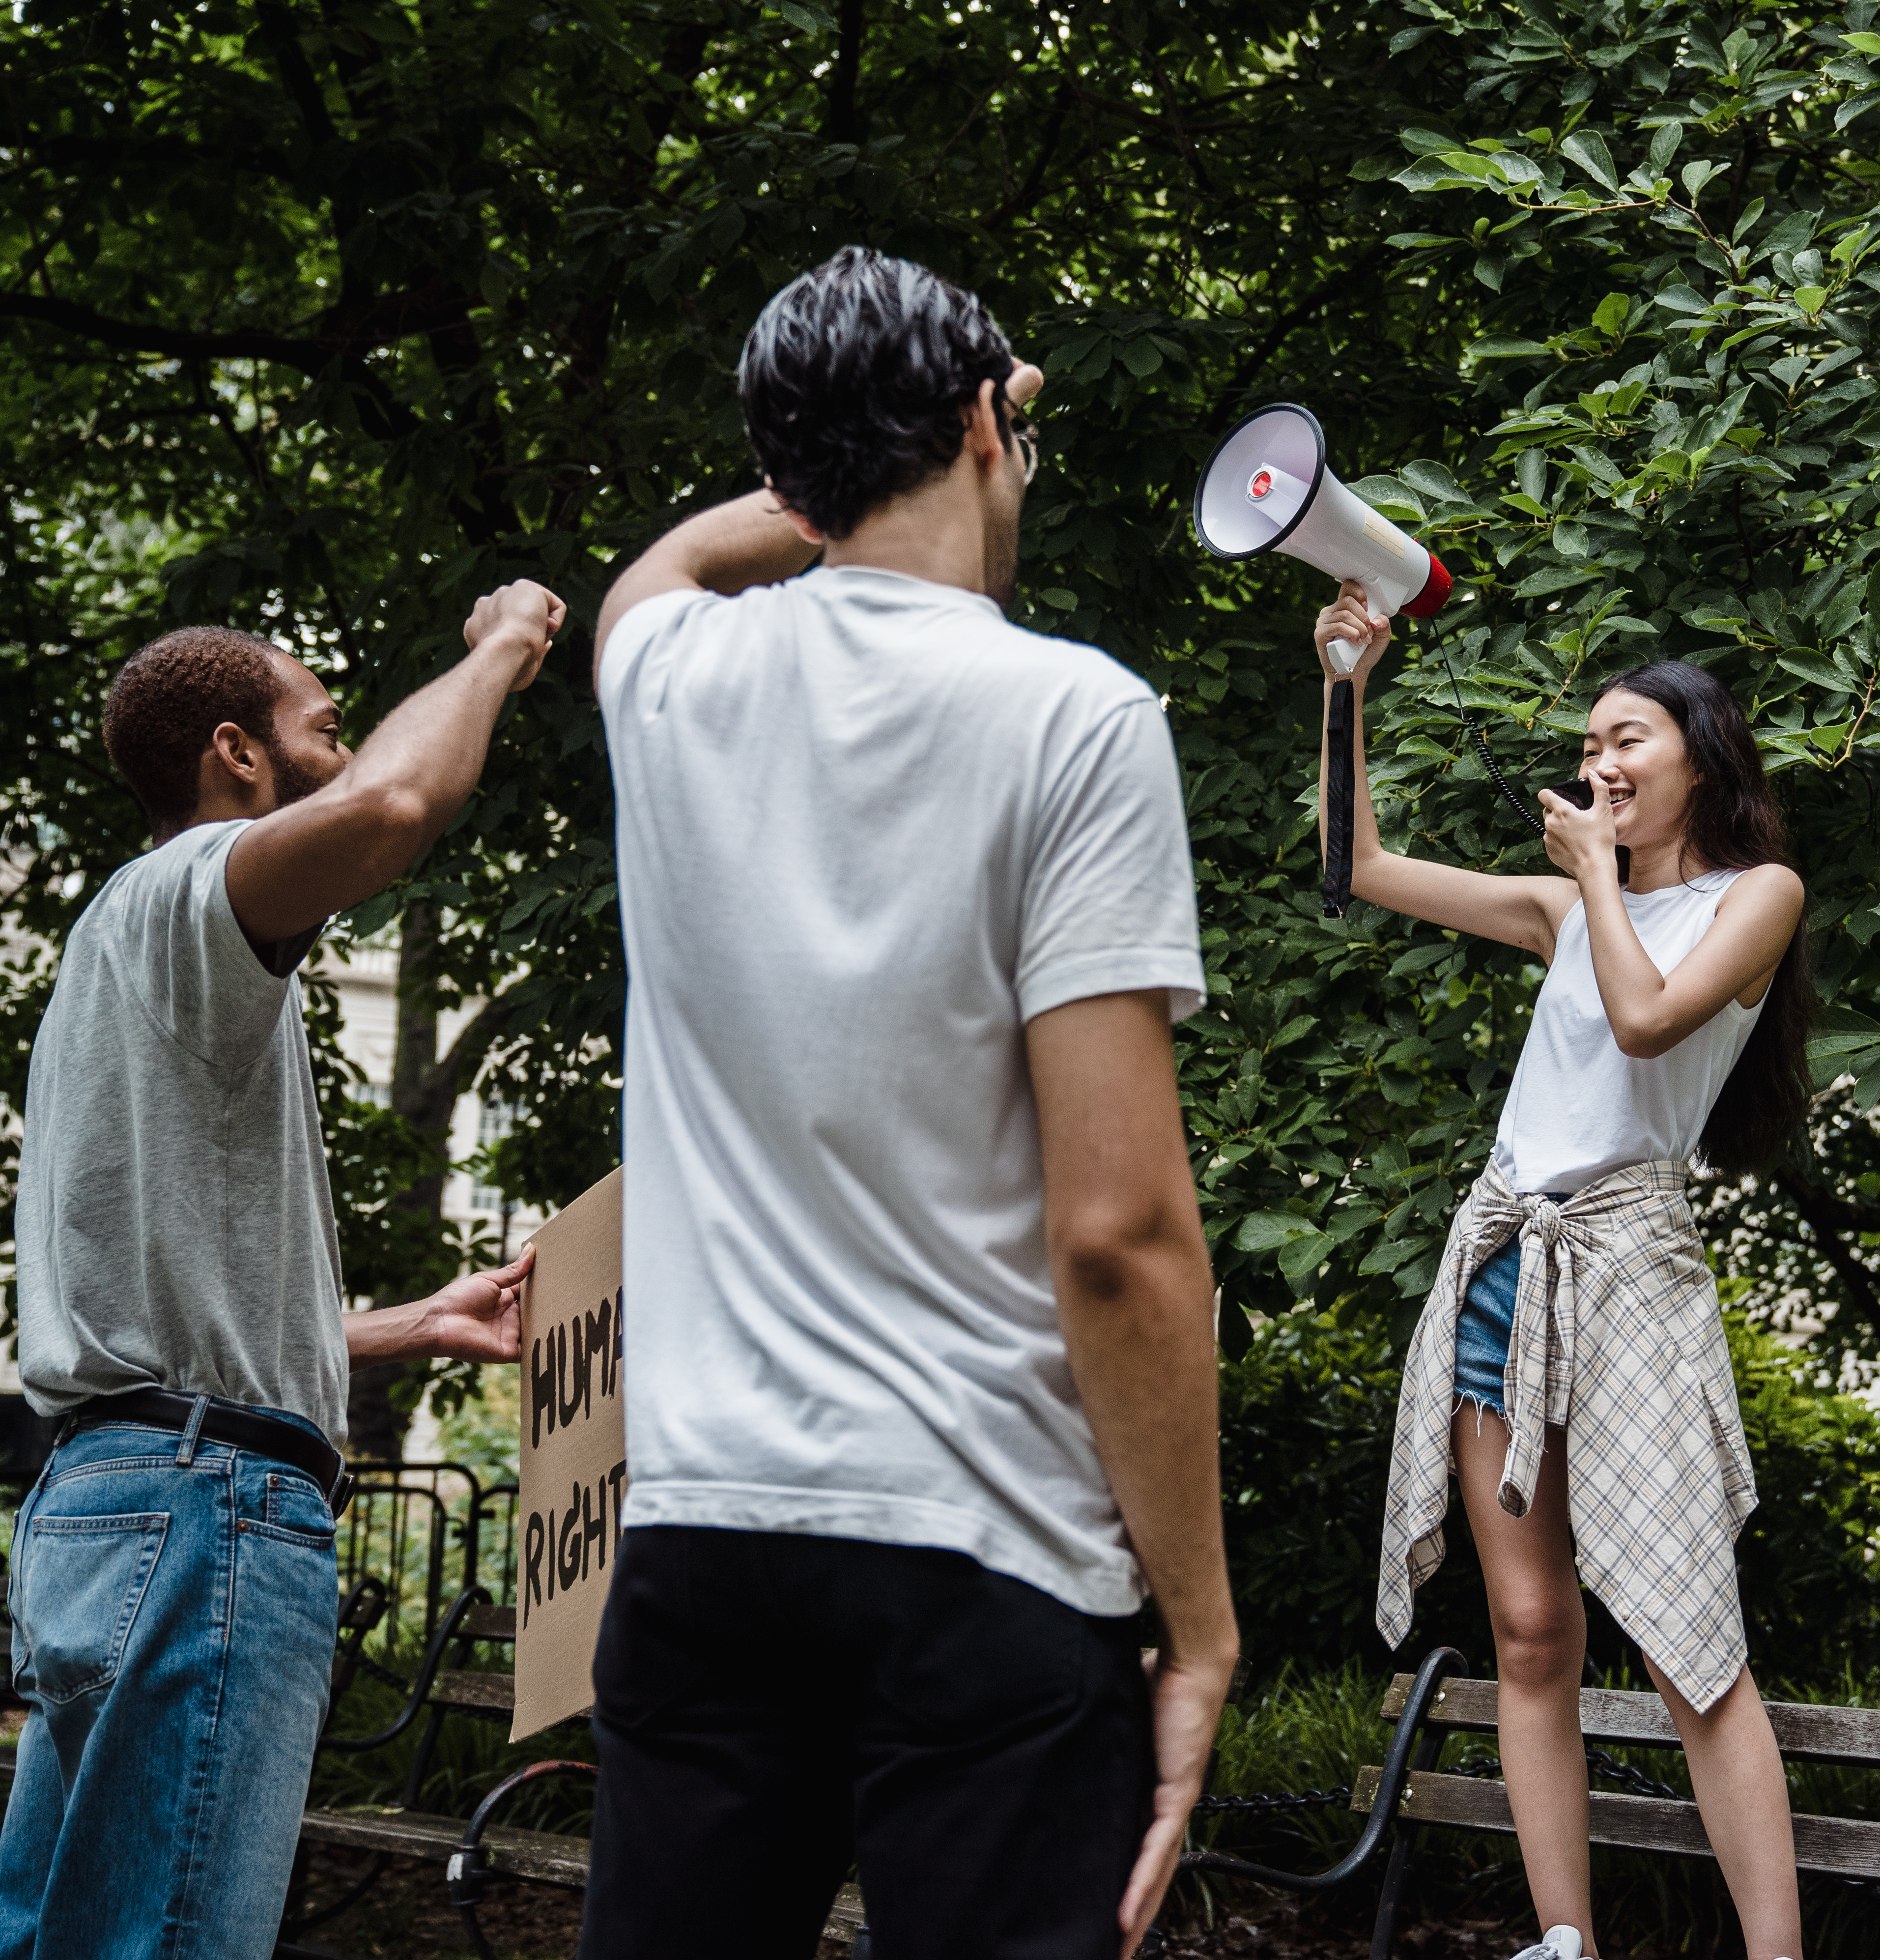
General Overview
Tenants in Washington DC, both in privately owned and DCHA properties, have the right to self-organize at their multi-family housing accommodation.
You can find the complete text of the law here: https://code.dccouncil.us/us/dc/council/code/sections/42-3505.06.htmlhttps://code.dccouncil.us/us/dc/council/code/sections/42-3505.06.html

Slide 3
The landlord is not legally allowed to stop you from…
Forming, joining, meeting with, or assisting one another; whether it be within or outside a recognized tenants’ association
1
Choosing representatives and meeting with management to discuss the concerns of the tenants’ association
2
Engaging in other activities for the purpose of mutual aid and protection
3
Choosing to refrain from organizing
4

Slide 4
If you have invited an organizer or attorney to your building, that person has rights as well!
Unless there is a CONSISTENTLY ENFORCED AND WRITTEN POLICY against canvassing, there is an implied policy in favor of canvassing. If there is no policy consistently enforced an organizer who is not a tenant has the SAME PRIVILEGES AND RIGHTS TO ACCESS AS OTHER INVITED PARTIES.
Even if there is a consistently enforced written policy against canvassing, an organizer can canvass the property while accompanied by a tenant

Slide 5
What activities can a tenant/organizer engage in under the law?
The property’s staff, security, and/or canvassing policy cannot interfere with a tenant or tenant organizer…
Distributing literature in common areas
This includes lobbies
Placing literature on tenant’s doors
Posting information on ALL bulletin boards
If bulletin board area is locked, tenant organizers must be given access

Slide 6
More activities that a tenant/organizer can engage in under the law
Convening tenant or tenant association meetings at any reasonable time and in any appropriate space that would reasonably be interpreted as areas that the tenant had access to under the terms of their lease
In your unit
Community Room
Lobby
Parking Lot
Other reasonably available spaces on the property

Slide 7
Even more activities that a tenant/organizer can engage in under the law
Assisting tenant in tenants’ organization activities
Any other activity reasonably related to the establishment of a tenant organization
The landlord nor their agents (maintenance, cleaning, security, leasing office staff, etc.) have the right to retaliate against a tenant or non-tenant organizer who engages in the protected activities
(or other activities reasonably related to tenant organizing, within or outside a tenants’ association)

Slide 8
Other activities that a tenant/organizer can engage in under the law
Formulating responses to owner actions, including:
Rent or rent ceiling increases or requests for rent or rent ceiling increases;
Proposed increases, decreases, or other changes in the housing accommodation’s facilities and services; and
Conversion of residential units to nonresidential use, cooperative housing, or condominiums;
Proposing that the owner or management modify the housing accommodation’s facilities and services; and
Any other activity reasonably related to the establishment or operation of a tenant organization

Slide 9
The landlord CANNOT retaliate for organizing
Retaliation might be any adverse action that the Landlord takes against you because you engaged in organizing activities. Retaliatory threats can be written or verbal.
Calling MPD and/or threatening someone with eviction because they are part of the Tenants’ Association are examples of interference and retaliation.

Slide 10
Why does this matter?
There are potentially stiff penalties for violating the organizing rights of tenants.
Civil fine of up to $10,000 PER VIOLATION
Suspension or revocation of business license or registration
Landlord cannot legally increase rent on any unit until registration is renewed
Court order demanding landlord respect the organizing rights of tenants
Personal liability to tenants or a tenants’ association.

Slide 11
What should you do if you believe your landlord is violating your right to organize?
Document you interactions with your landlord.
Remember which activities are protected.
Use email when making requests to the landlord.
The landlord does not have the right to take down your flyers, limit your access to bulletin boards, or declare that all community spaces are off limits.
If the landlord calls you to discuss an issue you are organizing around, send a follow-up email after the call with the details of the call for future reference.
If you or a non-tenant organizer is stopped from engaging in a protected activity, document the interaction.

Slide 12
What should you do if you believe your landlord is violating your right to organize?
Contact Washington Lawyers’ Committee for an intake interview:
Kelechi Agbakwuru
kelechi_agbakwuru@washlaw.org
202-319-1000, ext. 129
Caroline Zagraniczny​
caroline_zagraniczny@washlaw.org
202-319-1000, ext. 112​

